Slide 1
FUNCTION FEATURES
by Mykola Sotula

Slide 2
AGENDA
Arrow functions
Default parameters
IIFE

Slide 3
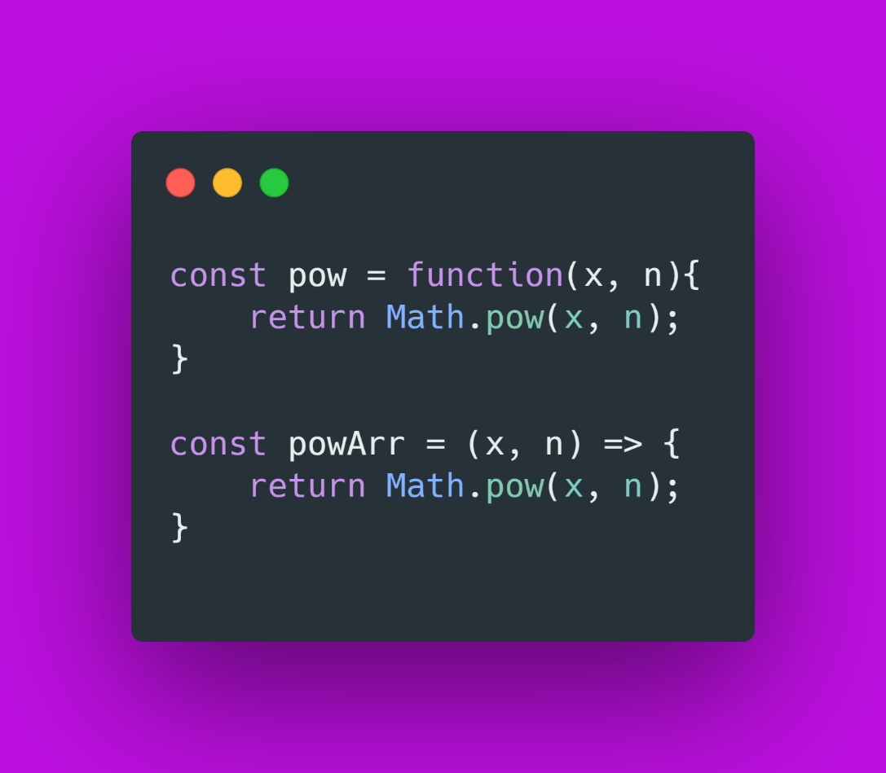
ARROW FUNCTIONS
An arrow function expression is a syntactically compact alternative to a regular function expression

Slide 4
ARROW FUNC vs REGULAR FUNC
An arrow function has not its own bindings to the:
this,
arguments,
super
Arrow function expressions are ill suited as methods, and they cannot be used as constructors.

Slide 5
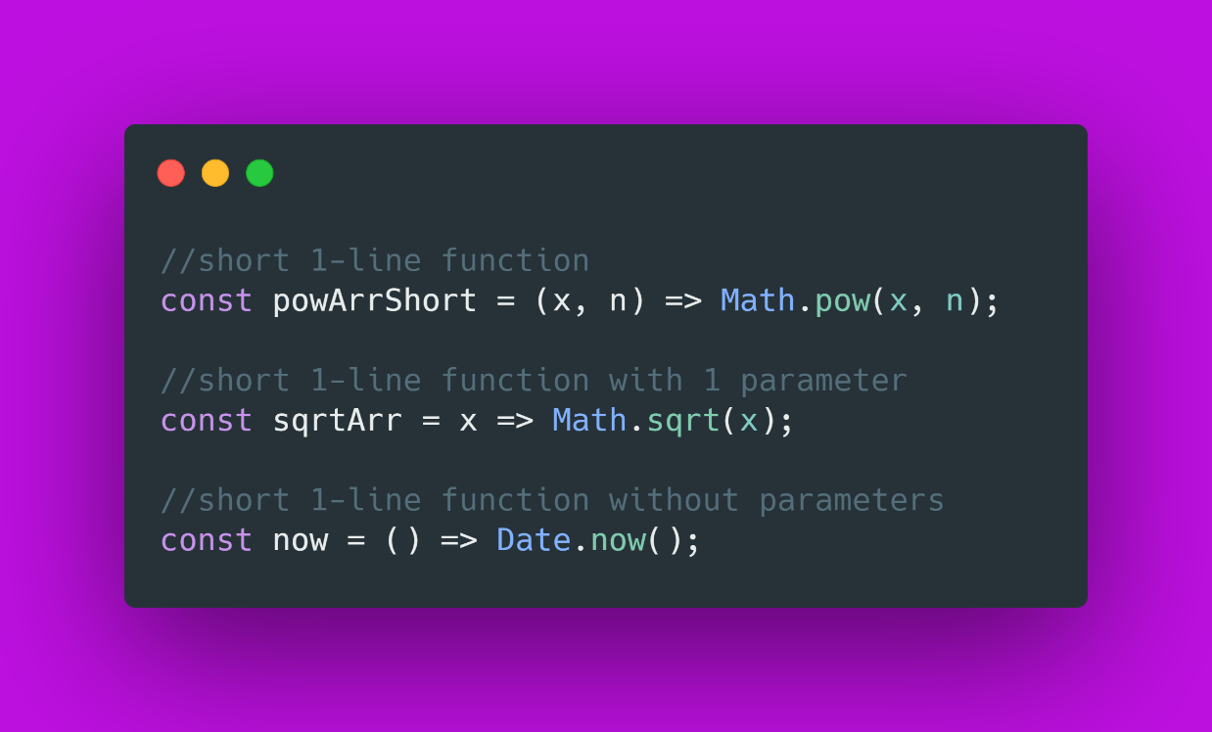
COMPACT FORM
If we have single line operation in function, we can use short-compact form of arrow function without {} and return

Slide 6
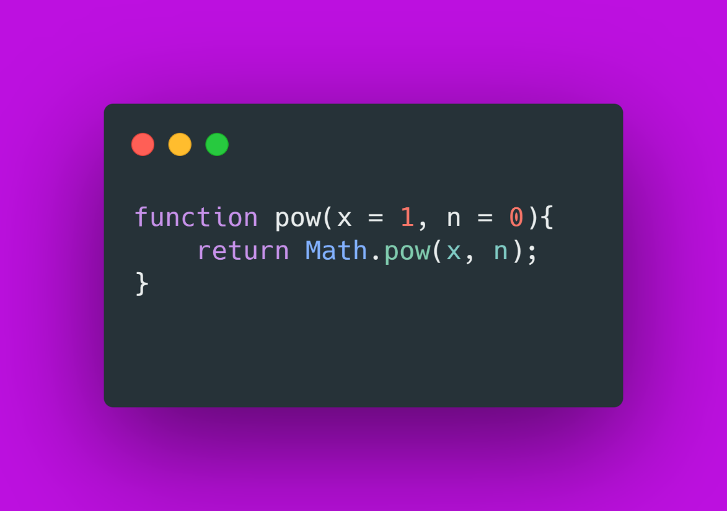
DEFAULT PARAMETERS
Default function parameters allow named parameters to be initialized with default values if no value or undefined is passed.

Slide 7
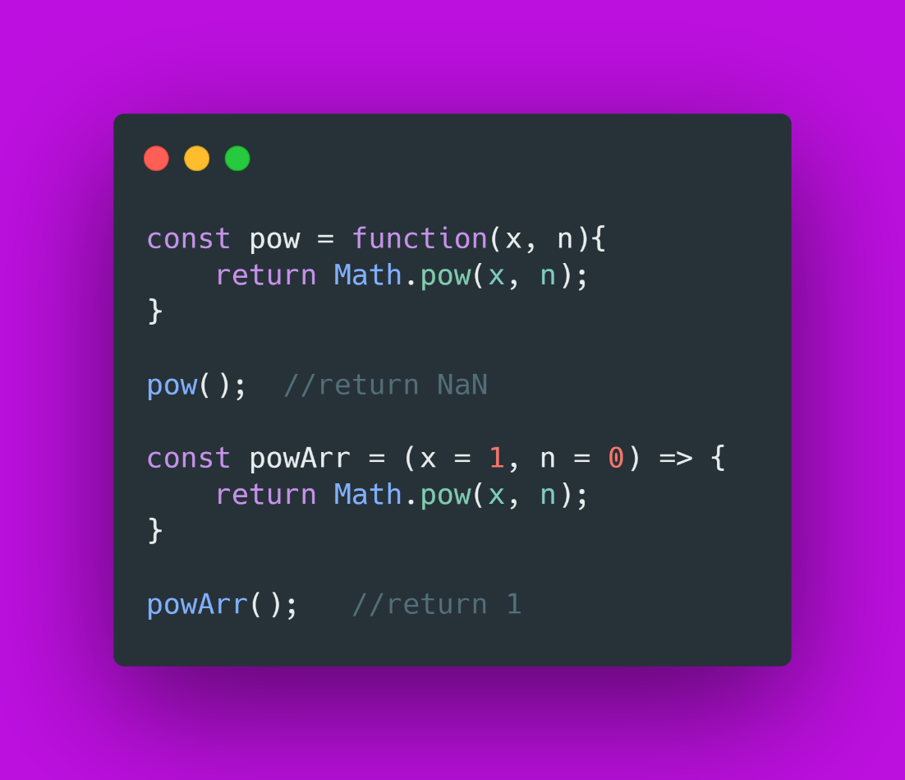
WHY WE NEED THIS?
Function parameters default to undefined. However, it's often useful to set a different default value. This is where default parameters can help.

Slide 8
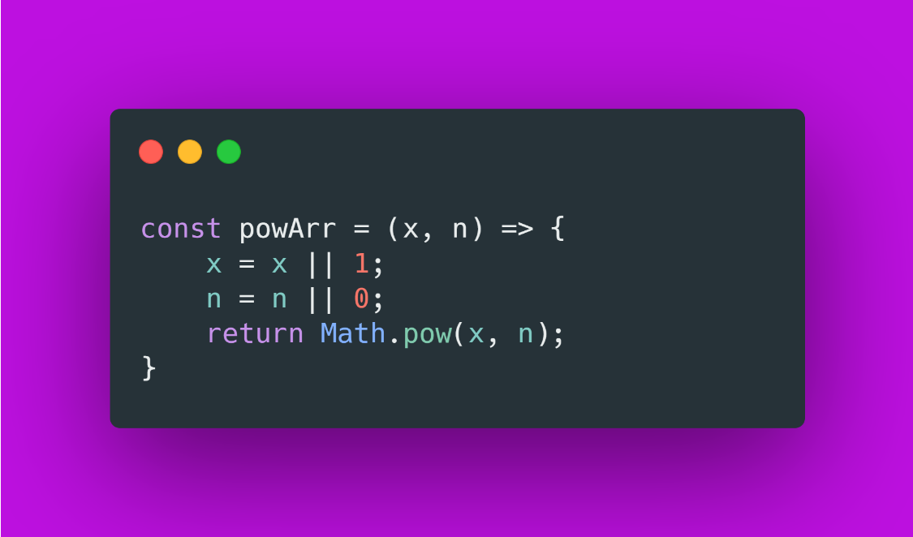
BEFORE DEFAULT PARAMETERS
|| (OR) operator can be used with operands that are not Boolean values, it can still be considered a boolean operator since its return value can always be converted to a boolean primitive.
Examples of expressions that can be converted to false are:
null,
NaN,
0,
empty string ("" or '' or ``),
undefined.

Slide 9
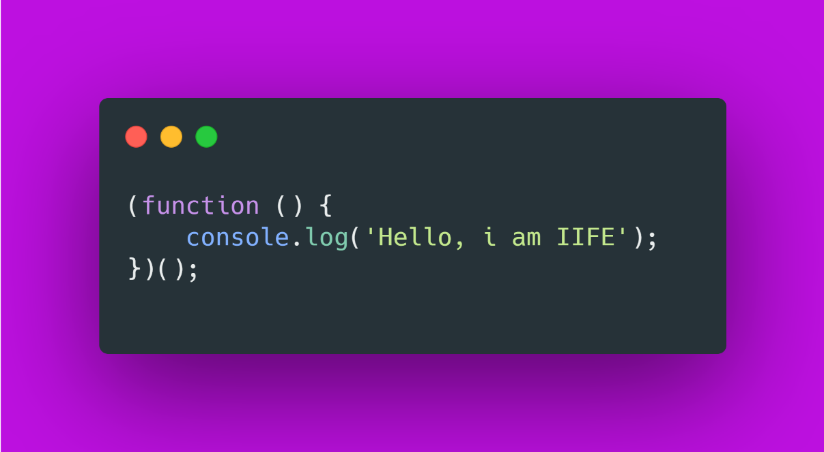
IIFE
An IIFE (Immediately Invoked Function Expression) is a JavaScript function that runs as soon as it is defined.

Slide 10
SELF-EXECUTING ANONYMOUS FUNCTION
It is a design pattern which is also known as a Self-Executing Anonymous Function and contains two major parts:
The first is the anonymous function with lexical scope enclosed within the Grouping Operator (). This prevents accessing variables within the IIFE idiom as well as polluting the global scope.
The second part creates the immediately invoked function expression () through which the JavaScript engine will directly interpret the function.

Slide 11


